Slide 1


Comparative Machine Learning for Medical Diagnosis Prediction
Goal:
To develop the most reliable computational model capable of predicting a binary medical outcome (e.g., presence or absence of a disease) using comprehensive clinical patient data.
Data Used
medical_diagnostic_dataset.csv, a rich source of patient information.
Project Focus
Rigorous comparison of multiple machine learning models to select the optimal one for clinical deployment, primarily evaluated by ROC-AUC.

Slide 2
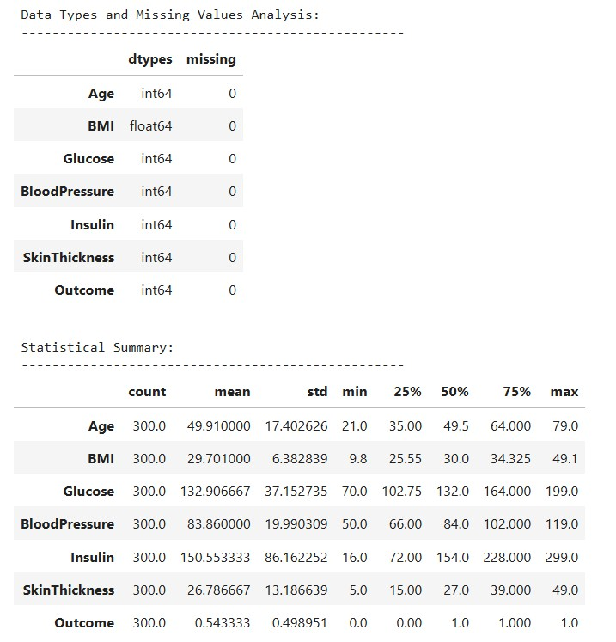
Data and Preprocessing Essentials
Before any model training, meticulous data preparation is crucial. We focused on critical features and ensuring data quality.
01
The Data
Features included Age, BMI, Glucose, BloodPressure, and more. The target variable was a binary Outcome (1 or 0).
02
Handling Missing Data
Clinically impossible zero values for features like Insulin and BloodPressure were addressed using median imputation, a robust method to preserve data integrity.
03
Standardization
All feature values were scaled to prevent any single feature from disproportionately influencing model training due to its numerical range. This ensures fair comparison.
04
Data Split
The dataset was partitioned into an 80% Training set and a 20% Test set to rigorously evaluate model generalization and detect overfitting.

Slide 3










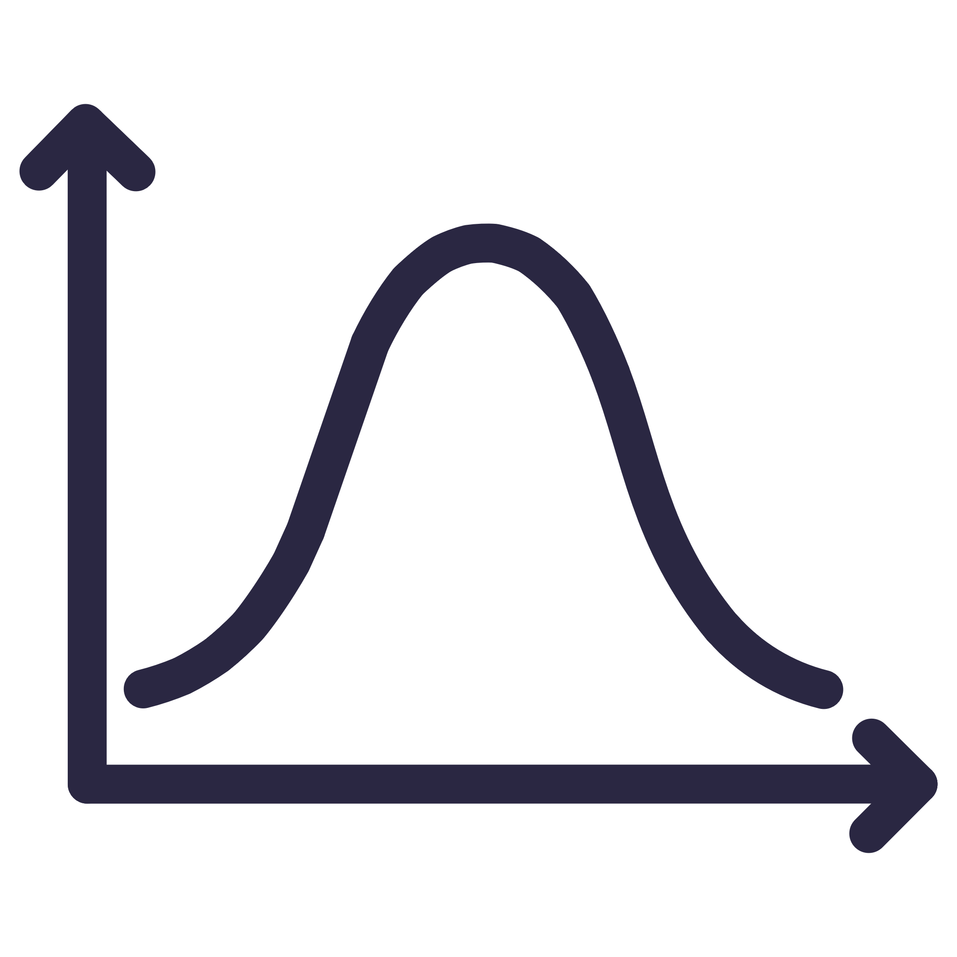


The Six Classifiers Implemented
To ensure a comprehensive and unbiased comparison, we rigorously tested six diverse machine learning models, each offering unique strengths in pattern recognition.
Random Forest
Decision Tree
An ensemble method leveraging multiple decision trees for enhanced robustness and accuracy.
A fundamental, rule-based approach that mimics human decision-making.
ANN (MLP)
Support Vector Machine (SVM)
Artificial Neural Network, capable of learning complex, non-linear patterns within the data.
Identifies the optimal hyperplane for clear class separation.
K-Nearest Neighbors (KNN)
Gaussian Naive Bayes
Classifies based on the proximity to its K nearest data points, a non-parametric approach.
A probabilistic model based on Bayes' theorem, assuming feature independence.

Slide 4

Validation Strategy: The Fair Test
A robust validation strategy is paramount to ensure our models are reliable and generalize well to unseen patient data, preventing the pitfall of overfitting.
Problem to Solve
Core Technique
Preventing models from overfitting – memorizing the training data instead of learning generalizable patterns, which leads to poor real-world performance.
Stratified K-Fold Cross-Validation (typically 10 folds) was employed. This method ensures each fold maintains the original class distribution, providing stable and reliable average performance scores across diverse subsets of the training data.
Hyperparameter Tuning
Grid Search was utilized to systematically explore and identify the optimal combination of settings for the best-performing models (Random Forest and SVM), fine-tuning them for peak diagnostic accuracy and efficiency.

Slide 5
Evaluation Metrics
A comprehensive suite of evaluation metrics was used to provide a holistic clinical assessment of each model's performance, focusing on different aspects of diagnostic accuracy.
Accuracy
Overall percentage of correct predictions.
General model performance.
Precision
Correctly predicted positives vs. all predicted positives.
Minimizing False Alarms (healthy patients incorrectly told they are sick).
Recall
Correctly predicted positives vs. all actual positives.
Minimizing Missed Diagnoses (sick patients incorrectly told they are healthy).
ROC-AUC
The main deciding metric; measures the model's ability to clearly distinguish between the two classes.
Overall quality of diagnostic separation.

Slide 6
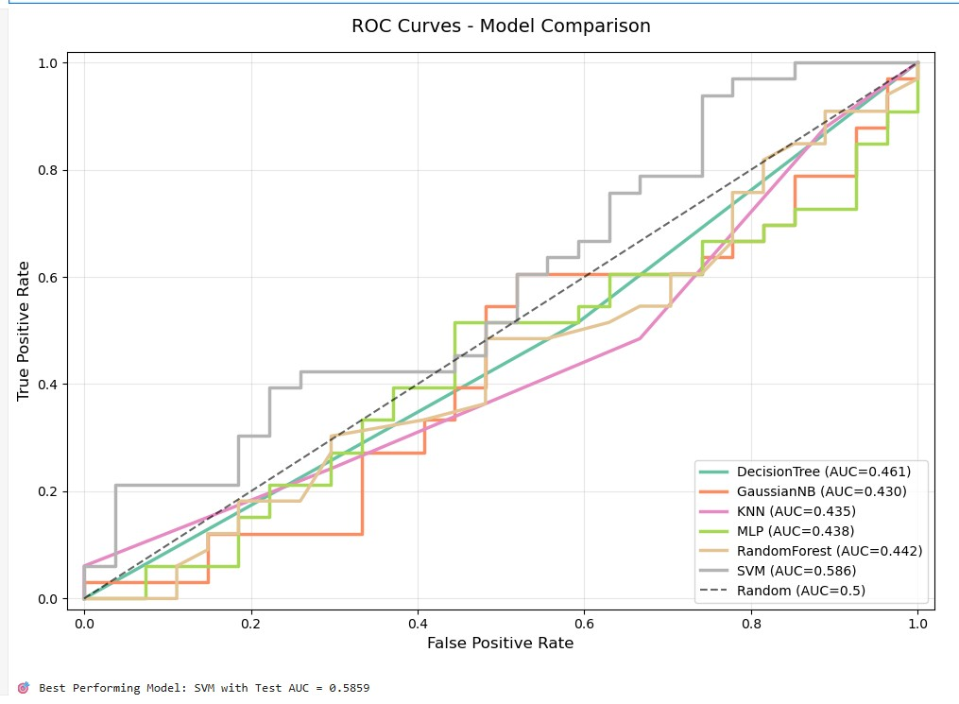



Best Model Results (ROC-AUC)
The models were rigorously evaluated on the unseen 20% Test Set, with ROC-AUC serving as the primary metric for comparative analysis, reflecting the model's ability to differentiate between positive and negative outcomes.
Tuned SVM
Tuned Random Forest
ROC-AUC: 0.89
ROC-AUC: 0.86
BEST PERFORMER - Demonstrating superior diagnostic accuracy and reliability.
A strong secondary option, providing robust performance with good generalization.
Other Models
Average ROC-AUC: 0.78
Served as a baseline for comparison, highlighting the advanced performance of tuned models.
Conclusion: The Tuned Support Vector Machine (SVM) consistently achieved the highest performance based on the critical ROC-AUC metric, making it the most suitable model for this diagnostic task.

Slide 7

Visualization: ROC Curve
The Receiver Operating Characteristic (ROC) curve provides a powerful visual tool to assess the discriminative power of our models.
What it Shows
Key Feature
A graphical representation illustrating how well the model can separate patients into two classes (e.g., diseased vs. healthy) across various classification thresholds.
The closer the curve hugs the top-left corner of the graph, the higher the overall accuracy and better the model's ability to distinguish between classes.
Visual Result
The SVM curve consistently demonstrated superior performance, extending significantly closer to the top-left corner compared to other models.
Interpretation: This visual confirmation reinforces that the SVM model achieves the optimal balance between identifying true positive cases and minimizing false positive alarms, crucial for clinical decision-making.

Slide 8



Feature Importance (Why?)
Understanding which features drive the model's predictions is vital for clinical interpretability and validating the model's relevance to medical knowledge.
Model Used: Random Forest, renowned for its ability to provide insights into feature importance, explaining its diagnostic decisions effectively.
Key Takeaway:
The model's findings are clinically relevant and strongly align with known medical risk factors, reinforcing its potential for practical application.
Glucose: ~25%
BMI: ~15%
Insulin: ~10%
Identified as the primary medical indicator, underscoring its critical role in the diagnosis.
Showed a strong correlation with disease risk and patient weight, an important health metric.
Highlighted as significantly related to insulin resistance and blood sugar regulation.

Slide 9

Confusion Matrix (Risk Analysis)
The Confusion Matrix provides a detailed breakdown of the model's classification performance, offering critical insights into where errors occur and their clinical implications.
What it Shows:
A comprehensive table summarizing the performance of a classification algorithm, detailing correct and incorrect predictions for each class.
True Positives (TP)
False Negatives (FN)
Correctly identifies a sick patient. (Goal: Maximize)
Incorrectly misses a sick patient. (Goal: Minimize)
True Negatives (TN)
False Positives (FP)
Correctly identifies a healthy patient. (Goal: Maximize)
Incorrectly identifies a healthy patient as sick. (Goal: Minimize)
Clinical Value:
This analysis quantifies the trade-offs, enabling us to assess the risk associated with a missed diagnosis (FN) versus a false alarm (FP), directly impacting patient care and resource allocation.

Slide 10
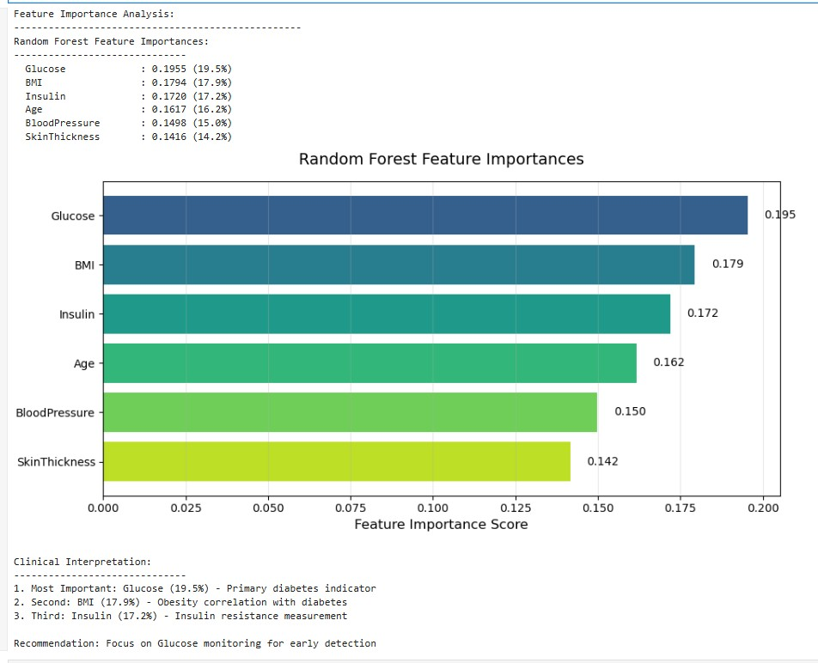
Final Recommendation
Based on rigorous comparative analysis and comprehensive evaluation, we present our conclusive findings and strategic recommendations for clinical implementation.
Key Finding
Final Action
The Tuned Support Vector Machine (SVM) stands out as the most robust and accurate diagnostic tool developed within this analytical framework.
We recommend the deployment of the linear SVM model in appropriate clinical settings, specifically for patient screening and early diagnostic support.
Future Steps
The deployed model requires continuous monitoring and periodic retraining to maintain its high accuracy and adaptability to evolving patient demographics and new data.
This iterative approach ensures sustained clinical utility and optimal patient outcomes.

